Slide 1


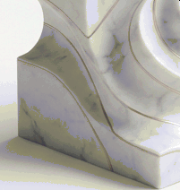
Digltal Family OTce
Arta unifies your financial life to help you grow, protect, and enjoy your wealth.
Arta Finance
G
NotebookLM

Slide 2


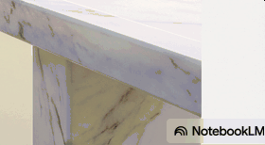

The ultra-rich manage their money and lives very differently.
They use a set of 'financial superpowers’ to grow and protect their money. They access private markets, use sophisticated strategies, and have a dedicated team.
This isn't just about having more mOney; it'S about having access to a different system. A system that has been historically unavailable to most.

Slide 3


Atawas builttogive you that system.
We are a next generation investment platform providing seamless access to public and private investment opportunities, along with expert financial services, previously reserved for institutions and the ultra-wealthy.
We unite deep tech and high finance to deliver your digital
family office.
Now open globally to Accredited Investors.
G NotebookLM

Slide 4



The Three Pillars of Your Digital Family Office
Exclusive Access | Al-Powered Intelligence | Institutional Trust
Access exclusive investment | Manage your portfolio with the | Grow your wealth together within
opportunities in private and public | help of AI that's purpose-built for | a secure, regulated framework
markets, curated for Arta members. | wealth management. | backed by industry leaders.

Slide 5




Invest in opportunities
previously out of reach.
Private Equity
Venture Capital
Move beyond standard stocks and bonds. Build a diversified portfolio with institutional grade assets once exclusive to the ultra-wealthy.
Private Credit
Private Infrastructure
“Millennial and Gen Z investors are building diversified portfolios earlier by tapping into private market investments... assets once exclusive to high-net-worth investors.“
Structured Products
-
Proiec1ed Gooch
Fneo Coupon Notes
G NotebookLM

Slide 6
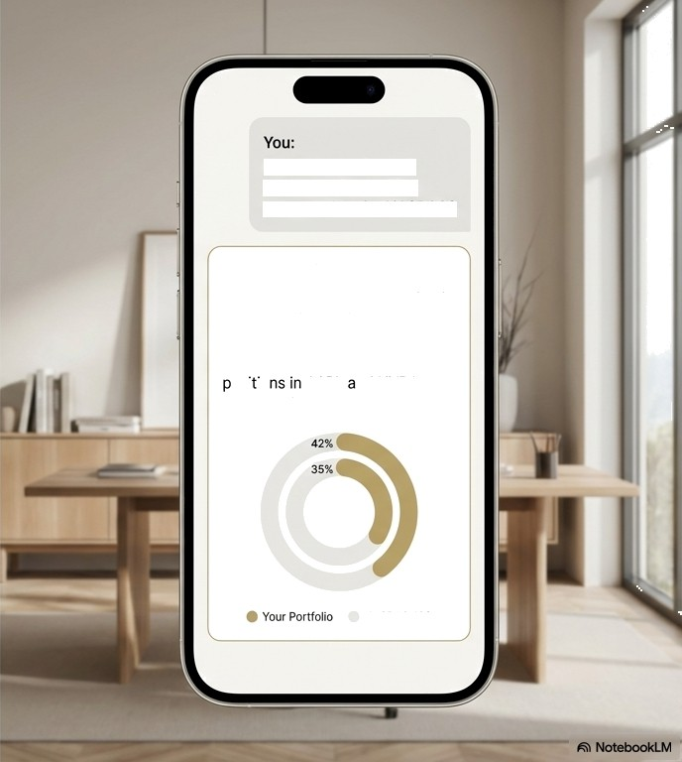



Meet your S dekick investing.
How is my tech stock concentration looking compared to the NASDAQ?
Arta AI Sidekick:
Your tech sector concentration is at 42°4, which is higher than the NASDAQ 100’s current weighting of 3S%. The main drivers are your osi io AAPL nd NVDA. Here's a visual breakdown:
Your Sidekick gives you a clear view of your holdings, instant performance comparisons, and easy-to-read stats that reveal how your portfolio measures up. Analyze, track, research, and question almost anything with just a conversation.
NASDAQ 100

Slide 7

Intelligence that works the way you do.
Talk, Email, or WhatsApp
Communicate in your preferred style, in multiple languages (ÇÂ, Português, 8t§Y À, and more).
Automated Workflows
Turn recurring chores like monitoring markets or surfacing trends into automated tasks.
Simple Portfolio Uploads
Start in seconds by entering tickers, or upload a brokerage statement (PDF or screenshot).
Multi-Asset Support
Track global equities, ETFs, and major cryptocurrencies. (Mutual funds, private funds, and more coming soon).
Shared Learning
Gain ideas from shared portfolios by other Sidekick users, sharing only what you want to.
W NotebaokLM

Slide 8
Choose the plan that's right for you.
^{s}’1stmonth free’*
Essential
$10/month
For personal investors checking in
on their portfolio every few weeks.
Pro
$50/month
For investors wanting daily/weekly
insights and deep research.
Advisors
$275/month
For advisors scaling their
expertise.
Includes multi-asset support, unlimited portfolios, chat/talk/whatsapp, statement parser.
Everything in Essential, plus more usage and access to specialized analyses (e.g., over-concentration checks).
Supports multiple clients, team plans up to 5 advisors, train on proprietary data.
Cancel anytime
No set up fees
Secure payment processing
G NotebookLM

Slide 9

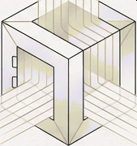

Built a foundation of institutional trust.
From app authentication and data encryption to asset custody and regulatory oversight, Arta unites deep tech and high finance to ensure security. Your wealth, and your trust, are paramount.
Regulation
Security
Partnership
G NotebookLM

Slide 10







Regulated, Recognized, and Secure.
Security & Regulation
Capital Markets
Services license
(CMS License 101441).
Assets held by the world's largest custodian.
Pmtectd p to $500K.
Industry Awards
Forbes
Fintech 50
2024
REAL SIMPLE
Smart Money Awards
2023
CGV Capital
Fintech
Innovation V
2023
j Nnde:h
Trailblazer
2023
G NotebookLM

Slide 11
What our investors
are saying.
“Combining advanced financial strategies with AI is the type of visionary thinking that brings about real step-function change... I am so impressed with what Arta has built.”
Eric Schmidt
Co Founder, Schmidt Futures;
Former CE0 & Chairman, Google
“Arta is harnessing the power of technology... By making access easier, quicker, and more complete, Arta has responded to those customer needs.”
Betsy Cohen
Chairman of Cohen Circle, Founder and
Former CEO of The Bancorp
“Arta Finance has chosen a massive unsolved problem... It's rare that a team with such achievements will join forces to startup.”
Shailendra Singh
Managing Director at Sequoia Capital India
G NotebookLM

Slide 12
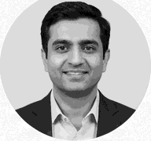
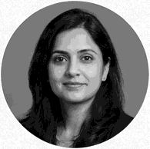
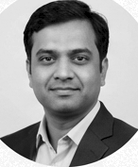
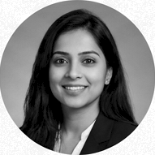
A team from the highest levels of tech and finance. finance.
Chirag Yagnik Co-founder & CIO
Nita Singh Head of Product
**Why We Left Google**: We are a team of senior tech professionals who experienced firsthand the challenge of making sophisticated wealth—building more accessible. We founded Arta on a mission to build the platform we wished we had for ourselves—uniting deep tech expertise with institutional financial acumen to open up a new world of opportunity.
Rajesh Kumar Head of Engineering
Anya Gupta Head of Operations
Professionals from global companies use Arta.
G NotebookLM

Slide 13



Join a community dedicated to building wealth.
Featured Podcast Guests
Grow your knowledge alongside a vetted community of Arta members and experts. Get direct access to insights from leaders in technology and finance.
Gokul Rajaram | Rah ul Rcy-Chowdhury | Sopnendu Mghanty
Boafd MemDw. CoinbaSe 8 Dcor0ash | CEO, Grammarly | Formef Chief FinTech Offi@r, MAS
Education
Five things to know about venture capital investing
Are you over-
concentrated?
“...unlocked diverse investments from
alternatives to private equity to take control of their financial future.”
Chris and Natasha Find their Financial ‘Fit' with Arta
G
NotebookLM

Slide 14




To celebrate our global launch, your first
digital family oTce is ready.
investments " !
managed --
are
7$rta.
k“ ,
[Create a Free.Account]
[ Chat with an Expert ]
Available now on iOS and Android
G NotebookLtVi

Slide 15
ARTA WEALTH MANAGEMENT PTE LTD | UEN 202239101 D
21 Collyer Quay #07-103, Singapore 049320
lmpoi1ant Disclosures: Arta Wealth Management Pte. Ltd. is regulated by the Monetary Authority of Singapore (“MAS“) and holds a Capital Markets Services license for fund management, dealing in securities and collective investment schemes (CMS License 101441). Our product and services are only available to inpacited I3y the Wealth's products, ton-make only available to Accredited Investors. Investing in securities involves risk, and there is always the potential of losing money. Past performance
is no guarantee of future results. This material has not been reviewed by the
Monetary Authority of Singapore.
0 Arta Finance 2025. All rights reserved.
G NotebookLM

